Slide 1
cityspace
team 12
zuckerbots
Notes:
Brief intro.

Slide 2


Notes:
Imagine a scenario:
During exam period
Urge to study harder

Slide 3

Notes:
Eagerly hope for a seat in study rooms

Slide 4

Notes:
No seats available

Slide 5





Slide 6



Notes:
To AC2

Slide 7

17
minutes
Notes:
Waste of time

Slide 8
Solution
Notes:
Waste of time

Slide 9

Notes:
Waste of time

Slide 10


Notes:
Waste of time

Slide 11

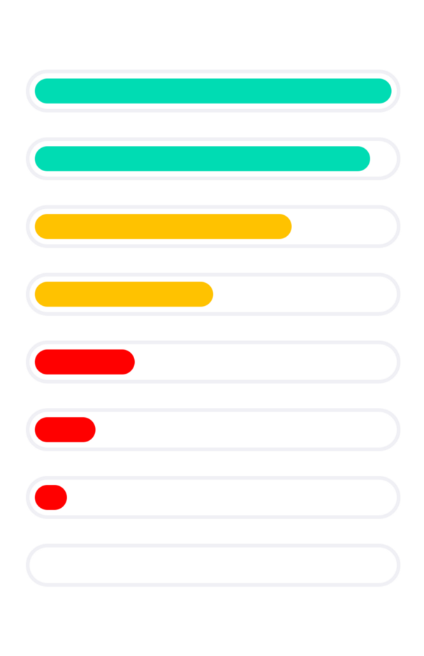
Notes:
Waste of time

Slide 12
Notes:
Waste of time

Slide 13
DEMO

Slide 14
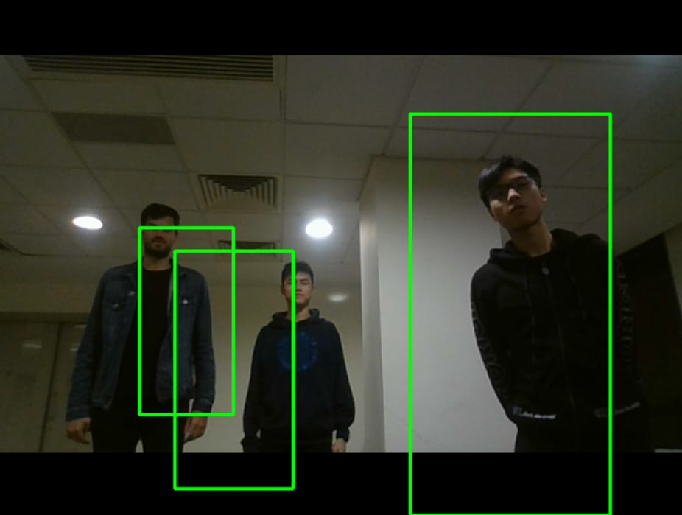

Slide 15
Why Us?

Slide 16
Originality
Content
Practicality
Technical Complexity
Aesthetics
Business Model
First in the Market
Eases lives
Uses existing CCTVs
AI Visual at the heart
Beautiful to use
Varied Uses

Slide 17
Increasing
Fidelity
Varied
Uses

Slide 18
Q & A

Slide 19
Child Safety Detection
Parking Space Detection
Bank Congestion Detection

Slide 20
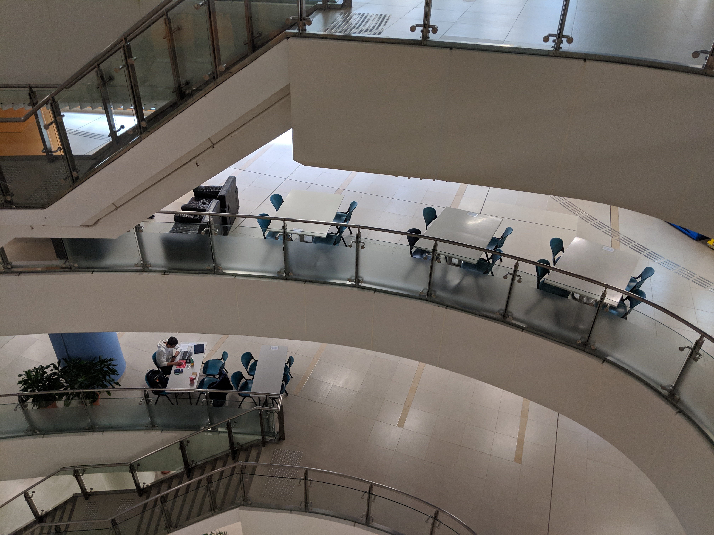

Slide 21
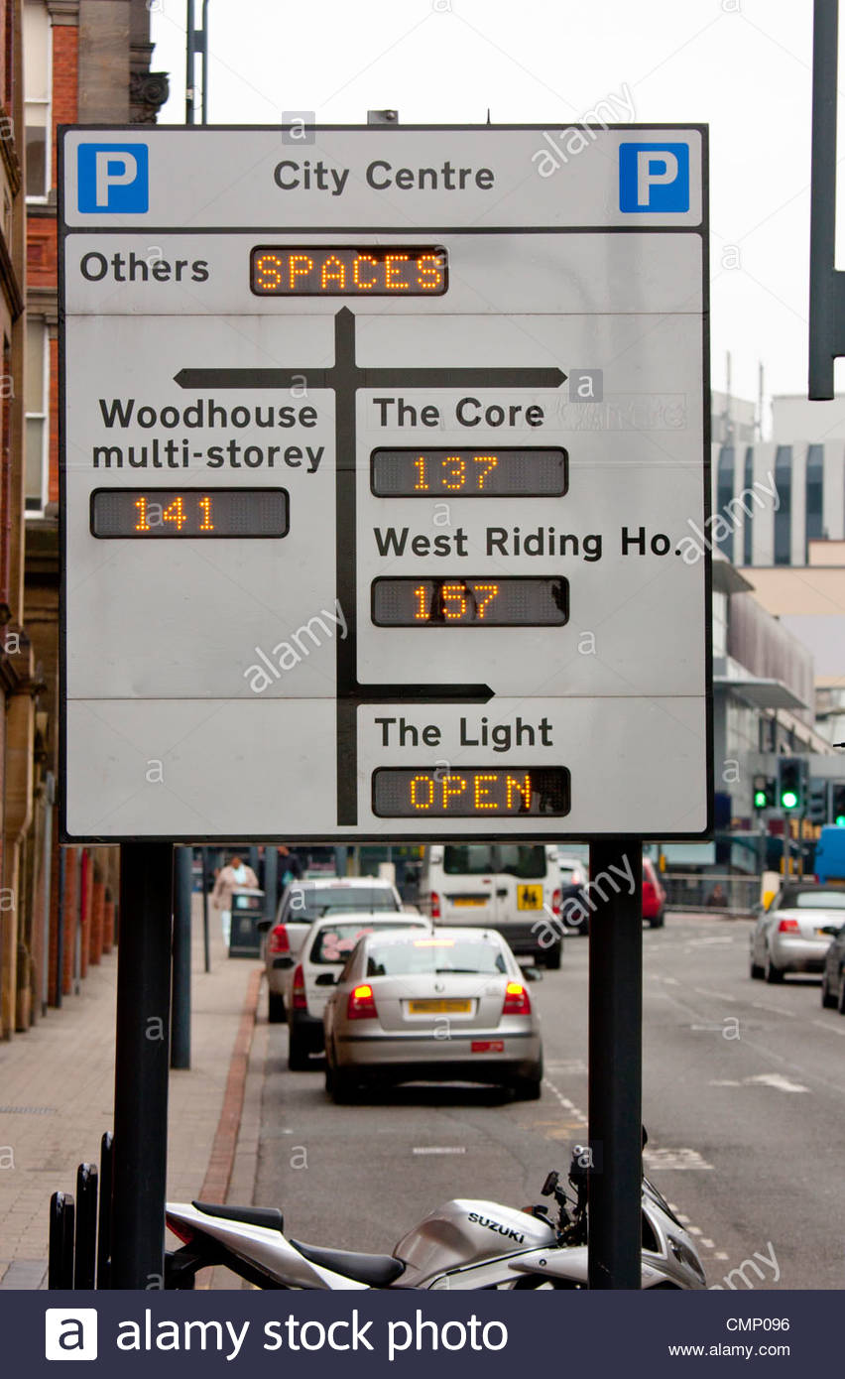

Slide 22
